Slide 1
Neuro Optimize
Project

Slide 2
Exploring Mental Health Data
This type of data analysis is essential for identifying patterns and potential predictors of depression. By understanding the correlations between lifestyle factors (like sleep and diet) and mental health, researchers can help target interventions and create preventive measures. - Use a neural network to identify relationships between lifestyle and mental health indicators and predict depression.

Slide 3
What model we used in dataset
we choose the Fourth model because it is well fitted and accuracy 93.76% as we decreases learning rate and added regularization L2

Slide 4
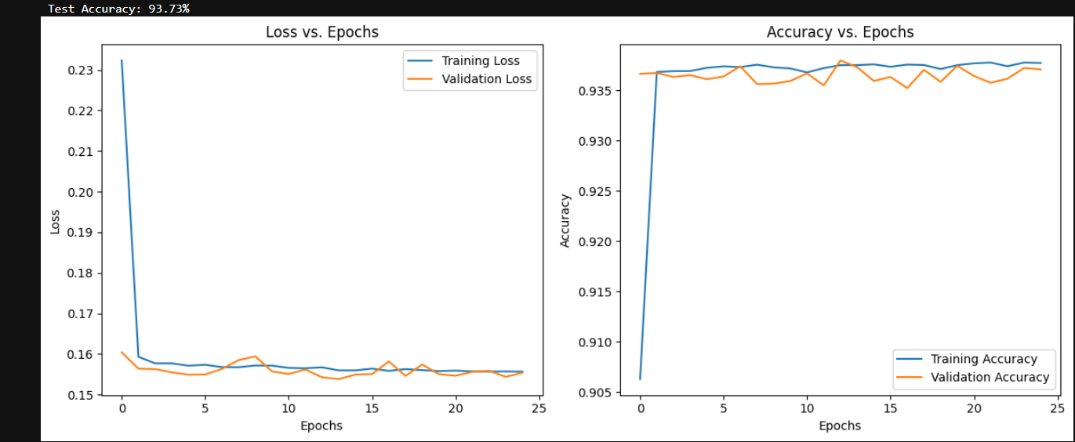
Changes happens when changing model Architecture
The model is well-fitted to the data with no major signs of overfitting or underfitting and Accuracy: 93.68%
Layer 1: Dense layer with 128 neurons and a 'sigmoid' activation function.Hidden Layer 2: Dense layer with 64 neurons and a 'ReLU’ Layer 3: Dense layer with 128 neurons and a 'sigmoid' activation function.Hidden activation function.Output Layer: Single neuron with 'sigmoid' activation for binary classification.

Slide 5
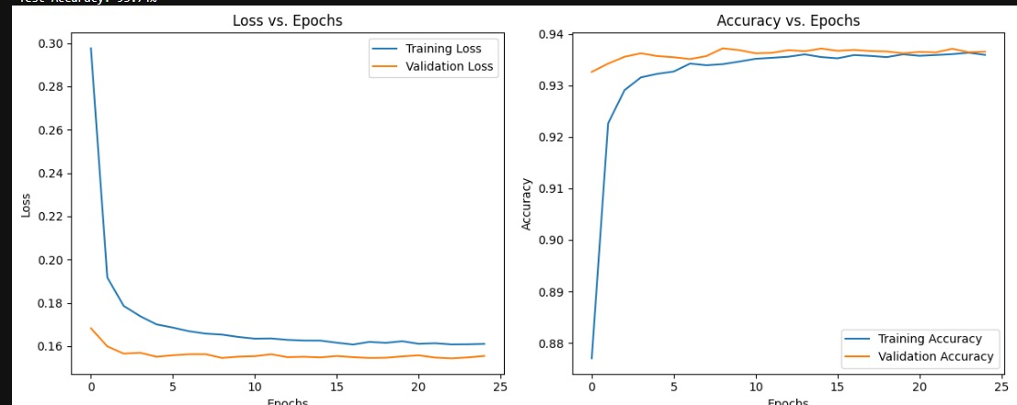
Changes happens when changing model Architecture
The model is underfitting and Accuracy: 93.74%
Additions to the Model Structure:using (regularization dropout method and adding layers)Dropout Layer 1: Dropout layer with a rate of 0.5 to prevent overfitting by deactivating 50% of the neurons.Hidden Layer 3: Added a dense layer with 64 neurons and a 'sigmoid' activation function.Dropout Layer 2: Added a second dropout layer with a rate of 0.3 to further reduce overfitting by deactivating 30% of the neurons.

Slide 6
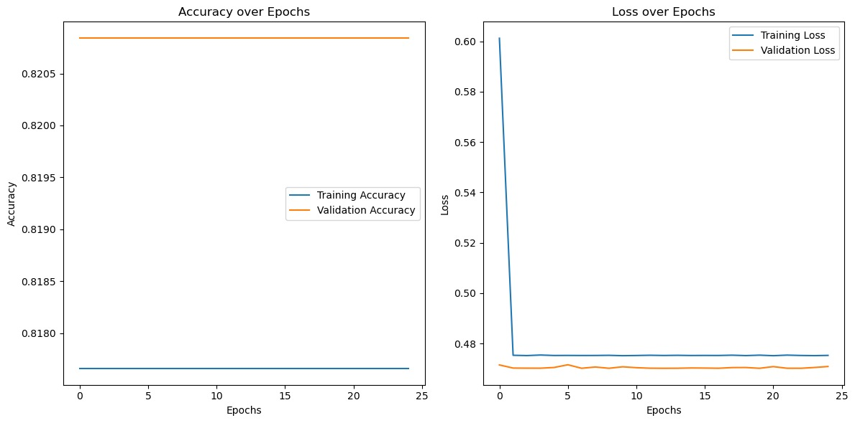
Changes happens when changing model Architecture
The model is not learning well from the data as indicated by the flat accuracy curve Accuracy: 81.83%
Layer 1: Input layer with shape (X_train.shape[1],)Hidden Layer 1: Dense layer with 128 neurons and a 'sigmoid' activation function, with L2 regularization.Hidden Layer 2: Dense layer with 64 neurons and a 'ReLU' activation function, with L2 regularization.Hidden Layer 3: Dense layer with 64 neurons and a 'sigmoid' activation function, with L2 regularization.Output Layer: Single neuron with 'sigmoid' activation for binary classification.

Slide 7
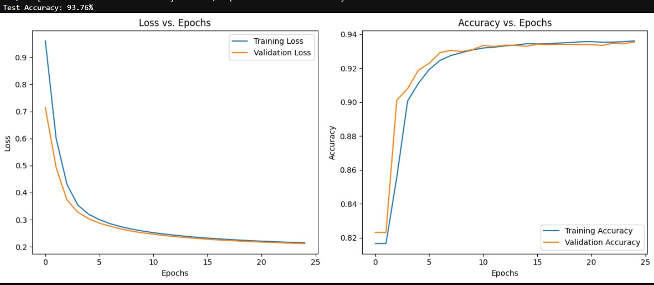
Changes happens when changing model Architecture
The model is well-fitted to the data with no major signs of overfitting or underfitting : 93.76%
Layer 1: Input layer with shape (X_train.shape[1],)Hidden Layer 1: Dense layer with 128 neurons and a 'sigmoid' activation function, with L2 regularization.Hidden Layer 2: Dense layer with 64 neurons and a 'ReLU' activation function, with L2 regularization.Hidden Layer 3: Dense layer with 64 neurons and a 'sigmoid' activation function, with L2 regularization.Output Layer: Single neuron with 'sigmoid' activation for binary classification.
With learning rate=0.0001

Slide 8
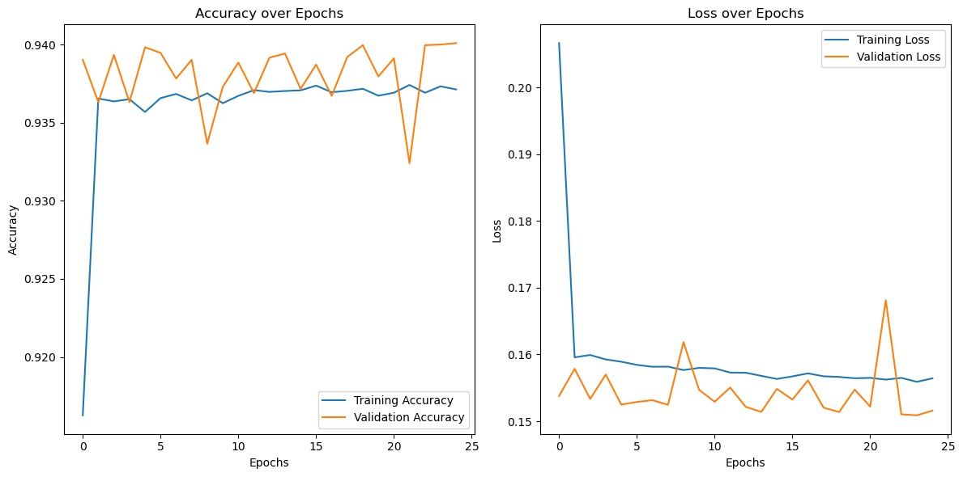
Changes happens when changing model Architecture
The model is signs of overfitting and Accuracy: 93.75%
Layer 1: Input layer with shape (X_train.shape[1],)Hidden Layer 1: Dense layer with 128 neurons and a 'sigmoid' activation function, with no regularization.Hidden Layer 2: Dense layer with 64 neurons and a 'ReLU' activation function, with no regularization.Hidden Layer 3: Dense layer with 64 neurons and a 'sigmoid' activation function, with no regularization.Output Layer: Single neuron with 'sigmoid' activation for binary classification. We use learning rate 0.001

Slide 9



THE TEAM
Malak Yasser
Ahmed Nada
Faress Hassan
2210400
22101167
22101096

Slide 10
THANKS!
addyouremail@freepik.com

